Slide 1

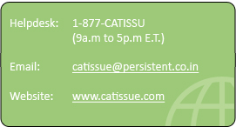
caTissue

Slide 2
Outline
Introduction
What is caTissue?
Release overview
General Requirements
Technical specification
Architecture
caBIG requirements
Functional requirements

Slide 3
Introduction
caTissue was developed as part of the caBIG program, a NCI initiative to speed research discoveries and improve patient outcomes by linking researchers, physicians, and patients throughout the cancer community.
‘ca’ stands for ‘Cancer’
Persistent, in collaboration with Washington University, has developed caTissue – a comprehensive, open source biobanking solution.

Slide 4
Introduction
caTissue's functionality goal is to ease the biospecimen banks in collecting, processing, storing, and distribution of human specimens for correlative science cancer research.
Other functional requirements of caTissue is
to track multiple specimens from the same participant
track refined materials (RNA, DNA, and Protein)that are used for molecular analysis
annotate biospecimens with accumulating experimental data

Slide 5
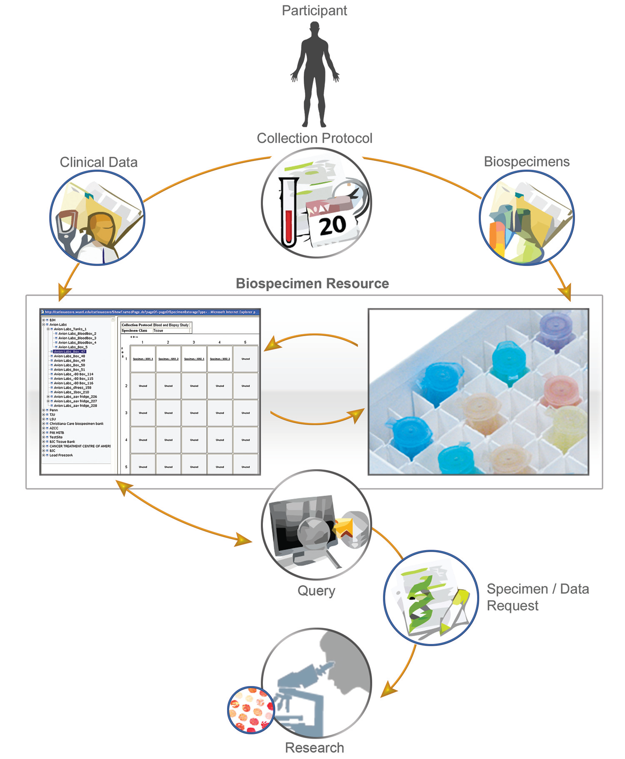
Introduction

Slide 6
caTissue -Outsourced Organizational Model
caTissue has been contracted by NCI to Washington University(WashU), St Louis.
WashU has outsourced the development of caTissue to Persistent Systems.

Slide 7
caTissue -Outsourced Organizational Model
Customers – Various cancer centers
PSL Support team
Sales
Prof.
Services
Marketing
Project Manager
PSL Development team
Software developers & testers
Technical Architects
Tech Pubs team
Business Analyst
Management team
NCI
WashU
SAIC
Adopters

Slide 8
Program Management
Contract given by NCI, head of decisions for caTissue – Ian Fore
Decides on budget and timelines
Program management contracted to
LiMing Shen - SAIC
Linda Schmandt -UPitt
Project development contracted to Washington University:
Rakesh Nagarajan – Project Manager
Mark Watson – Domain expert – Brain behind caTissue
Other funded adopters – requirement decisions and end user testing:
University of Pennsylvania – Tara McSherry
Yale University- Michael Krauthammer
University of Pittsburgh - Linda Schmandt
Thomas Jefferson University - Jack London
Indiana University- Gunther Schadow
Other stakeholders are actual end users who are involved ign end user testing

Slide 9
Demo Site
Please visit application demo site
URL : http://catissue.wustl.edu
User : admin@admin.com
Password: Login123

Slide 10
Release overview
Following versions of caTissue so far has been released
caTissue Core 1.0
caTissue Core 1.1
caTissue Core 1.2
caTissue Core 1.2.0.1
caTissue Core 1.2.2
caTissue Suite 1.0
caTissue Suite 1.1

Slide 11
General Requirements
caTissue is a open source web based application
Adherence to caBIGTM compatibility guidelines
General biospecimen tracking functionality
Authentication and Authorization of data
Extendibility to integrate with other systems

Slide 12
Technical specification
Software | Version
JDK | 1.5
Struts | 1.1
Hibernate | 3.1.3
Jboss | 4.2.2.GA
MySQL | 5.0.45
Oracle | 10.2.0.2
Apache Ant | 1.7
CSM | 3.2
caCORE | 3.2.1
caGrid | 1.2

Slide 13
J2EE Architecture
caGrid Data Service
User Interface
(JSPs/Flex/AJAX)
Access layer
caTIES Pipeline
caCORE API Interface
Struts Action Layer
Controller
HL7 Loader
DeId pipeline
Concept coder
Business Logic Layer
n-tier biz. Logic layer
CRUD Operations
Simple Query
Advanced Query
Dynamic Extensions
DAO Factory
(Hibernate DAO / JDBC DAO)
CSM Interface
Audit Layer
caTissue , CSM, Metadata, DE
Highlights: MVC architecture, modular code, appropriate level of abstraction layers, all access to data is via business logic layer and validation performed for caCORE API as well

Slide 14
caBIG requirements
The main goal of the Tissue Banks and Pathology Tools (TBPT) Workspace is to provide for the implementation and integration of tissue bank and pathology tools and infrastructure components that will facilitate information sharing
caTissue must be caCORE and caGrid enabled and must be capable of query multiple instances of caTissue Suite instances

Slide 15
caBIG requirements
Adherence to HIPAA guidelines
Integration with NCICB’s CSM module that provides a comprehensive solution to common security objectives.
caTissue application must use authentication APIs provided by CSM to validate and verify a user’s credentials and allow access to the application.
caTissue must use authorization APIs provided by CSM to grant access on data, methods, objects and allows user to perform only those operations or access data to which they have access privileges.

Slide 16
Functional requirements
caTissue is an integrated system supports
caTissue Core module
caTIES
Dynamic Extension
Query module
caBIGs Common Security module
caBIGs caCORE API
caBIGs caGrid data service

Slide 17
caTissue Core
The caTissueCore provides functionality as:
Administrative
Biospecimen

Slide 18
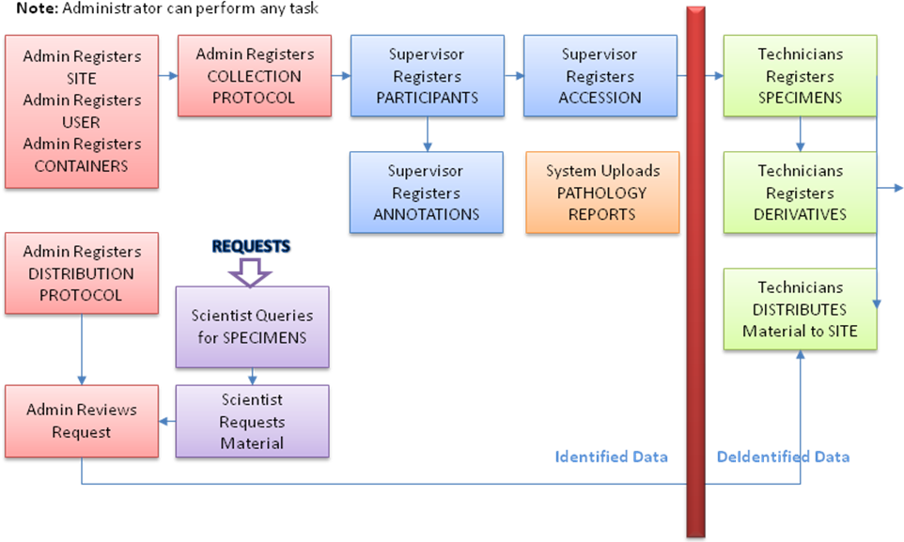
Functional Block Diagram

Slide 19
Functional Outline
Register new user
Log In
Summary Data
Add / Edit Administrative Data
Add / Edit Biospecimen Data
Search
Simple Search
Advanced Search
Query Result Export
Specimen List
Order specimens
Add / Approve Users
Add / Edit Sites
Add / Edit Institutions
Add / Edit Departments
Add / Edit Storage Type
Add / Edit Storage Container
Add / Edit Collection Protocol
Add / Edit Distribution Protocol
Add / Edit Local Extensions
Distribute Specimens
Add / Edit Patient
Register Patient
Add Specimen Collection Group
Add Specimen
Derive and Aliquot Specimen
Add Clinical / Pathology Annotations
View Surgical Pathology Reports

Slide 20
Administrative Function
Administrative data contains
User
Institute
Department
Site
Storage Container
Collection Protocol
Distribution Protocol
Specimen Array Type
Local Extensions
Conflicting reports

Slide 21
Administrative Function
Supports Add/Edit operation on administrative data
Assign roles and define data authorization for registered users
Defines Collection protocol, basically a rule for a particular research defining when, what specimens to be collected from registered patient/participant
Defines Storage container hierarchy of the bank. E.g. Freezer, box etc. its capacity, restrictions.

Slide 22
Administrative Function
Dynamic form creation for annotating participant, specimen data
Dynamic form provides ability to define more attributes (which is not available in static model ) for user to capture more information related to research

Slide 23
BioSpecimen Function
Add/Edit participant information
Register participant to a collection protocols
Mark specimen collection
Store specimens at particular container
Technician/Supervisor users track specimen events, basically operation performed on specimen
Scientist users can order the specimen
Specimens are distributed for further research to scientist

Slide 24
caTIES
caTIES provides a method to allow caBIG adopters to automate the process of coding, storing and retrieving data from free-text Pathology Reports.
caTIES add value to caBIG by reducing the time required to extract patient information from Pathology Reports, while ensuring a common vocabulary and terminology structure to facilitate the storage, query, retrieval and sharing of data associated with pathology samples.

Slide 25
Surgical Pathology Report (SPR) Support
Load SPR
De-identify SPR
Concept Code SPR
Load SPRs from HL7 feed from CoPath and associate it with relevant Participant and Specimen
DeIdentify reports using Harvard DeId Scrubber (open source free)
Concept Code free text SPRs using EVS Metathesaurus
Notes:
25

Slide 26
Dynamic Extension
Dynamic Extensions allows J2EE applications to be extended to accommodate new datasets without writing any new code.
The Metadata Repository of DE is reused in caBIG Compatibility Review System and caB2B projects
Development of first version was jointly funded by UC Davis and WashU
Based on Model Driven Architecture - Can support any complex UML model - all standard data types, associations, cardinality, inheritance, etc.
Extended model can be exported as XMI file for caBIG compatibility review, silver API and caGrid service generation.
Notes:
26

Slide 27
Functionality Overview
Create new Dynamic Extension
Using the DE Form Builder User Interface
Data entry – Auto Generated User Interface
Query using caTissue Suite Query Interface (static + DE)
1
Using Import XMI Option
2
3
1
caGrid enable
Share DEs with other caTissue instances
e
d
Generate caCORE API
Export XMI From DE
c
caBIG compatibility review
a
Run XMI through SIW
f
b
Notes:
27

Slide 28
Example Usage
caTissue Participant Class
Notes:
28

Slide 29
Query module
Query any object in caTissue
Query with conditions on multiple objects
as long as there exists a valid path between the objects in the UML model
Define view to contain any object in the view
Save query, export data
Proceed to bulk operations, shipment or order biospecimens.

Slide 30
Query module
The query interface is fully metadata driven - user interface, SQL generator and results view - and therefore highly flexible.
Just need to upgrade the metadata across versions of caTissue – no additional code required
Metadata contains manually curated meaningful (direct and indirect) paths so that end users need not know the UML model of the application.

Slide 31
Query Architecture
Metadata based User Interface
Dynamic Extension Metadata API
Create Query data object from the UI
Save Query
SQL Query Engine
JDBC Interface
execute
Results Processor
CSM Manager
filter PHI data
Results View
Due to its metadata nature, the same query engine is integrated in multiple applications without any additional code changes.
The same design is reused in caB2B to develop DCQL based query interface, and we are currently working on a XQuery based query interface.

Slide 32
Why metadata driven architecture?
caTissue has ~225 classes and ~1500 data elements
Imagine building a specific query interface which supports querying the whole dataset
Ability to support querying of Dynamic Extensions
Long term maintenance with respect to model changes and local customizations
No code changes required
Power of querying is in the hands of the (advanced) end users rather than DBA or data managers
Does not take time for novice end users to become advanced!

Slide 33
Filtering Patient Health Information (PHI) data
In caTissue, filtering of query results is always based on Collection Protocol (CP). Three use cases for filtering:
Read denied on a CP
Access to only deidentified data on a CP
Full access on a CP
In short, all access is controlled based on the CP to which the object belongs. For non CP based data, there is no filtering involved.

Slide 34
Filtering PHI data design
If Query includes CP based data, include CP ID in the query
Execute Query
caTissue CSM Manager
(contains in-memory privilege cache for the logged in user)
Results Processor
filter PHI data based on CP id
Results View
In short, the caTissue CSM Manager contains information about the CPs to which the logged in user has access to. Therefore during filtering, there is no CSM API call made. All requests are serviced with in-memory data.

Slide 35
caCORE and caGrid
Standard caCORE SDK generated API directly accesses the database. It does not perform any business logic check while performing the CRUD operations.
Extended caCORE writable API to support
caTissue application business logic
PHI filteration

